Slide 1

PRACTICAL
OBJECT-ORIENTED
DESIGN WITH UML
2e
Chapter 9:
Interaction Diagrams

Slide 2
Interaction Diagrams
Objects interact by passing messages
The messages define the system’s behaviour
UML defines two types of diagram for showing interactions:
  collaboration diagrams
  sequence diagrams

Slide 3
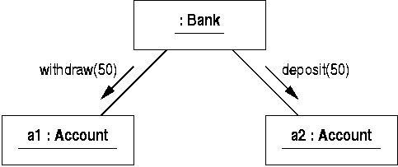
Collaborations
A collaboration defines a set of linked objects
  object diagrams define collaborations
Interactions are defined by adding messages to collaborations

Slide 4
Problems with Object Diagrams
Object diagrams show ‘snapshots’
  they show specific objects, not the general case
  they show a fixed number of objects and links
  they cannot show alternative functionality
A more general method is needed to specify behaviour

Slide 5
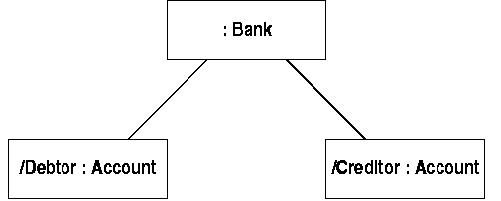
Classifier Roles
Define collaborations using classifier roles
  these are like ‘object variables’
  they have a base class
  and can have a name describing the role

Slide 6
Roles and Objects
Objects can play different roles in interactions
An object can be substituted for a role if
  it is an instance of the base class of the role
  or one of its subclasses
Often objects are used in place of roles
  but understood as being ‘prototypical’ objects
  they have the same function as classifier roles

Slide 7
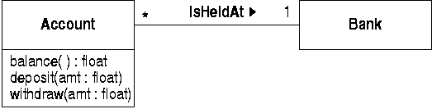
Association Roles
Association roles connect classifier roles
  they specify that object playing those roles can be linked together
Often, association roles derive from a base association:

Slide 8
Object Communication
Objects linked by an instance of an association can communicate
Communication is also possible with:
  objects passed as message parameters
  local variables inside other objects
  globally accessible objects
  messages sent by an object to itself

Slide 9
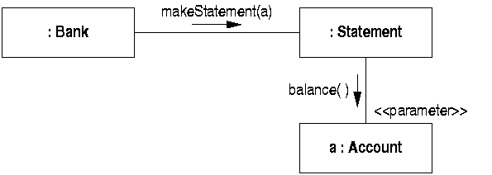
Association Role Stereotypes
It can be important to show these forms of communication in interactions
They are specified by adding stereotypes to association roles

Slide 10
Sequence Diagrams
Show classifier roles only
Time flows down the diagram
Each role has a lifeline
  showing when objects playing that role exist
Messages shown as arrows between lifelines
Activations show when an object is active processing a message
Return messages also shown

Slide 11
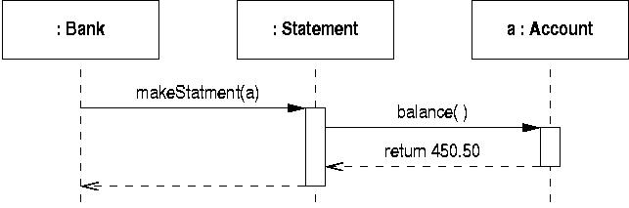
A Simple Sequence Diagram
This corresponds to the interaction shown previously

Slide 12
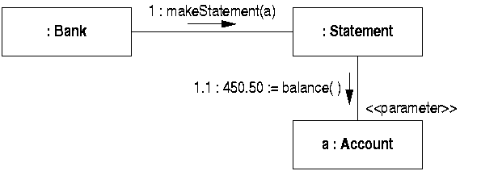
Collaboration Diagrams
Show classifier and association roles
Messages also have
  sequence numbers to indicate order
  optional return values with ‘:=’ notation

Slide 13
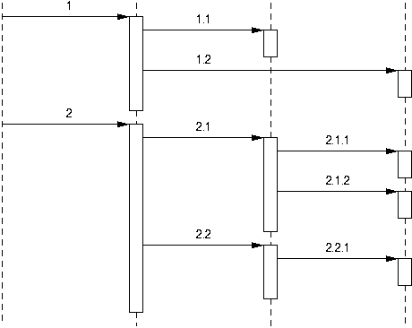
Hierarchical Numbering
Two ways of showing message sequencing

Slide 14
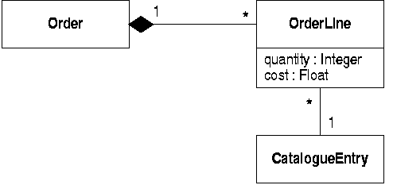
Orders and Order Lines
Add orders to the stock control system:

Slide 15
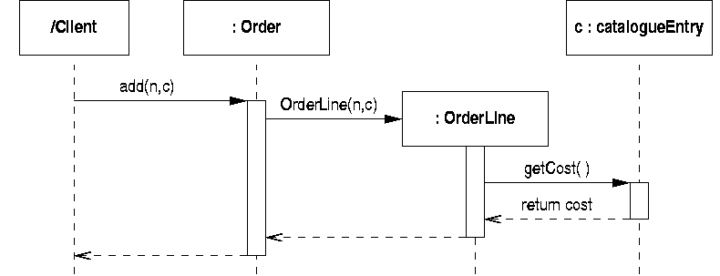
Creating an Order Line (1)
Adding an item to an order creates a line:

Slide 16
Object Creation
On a sequence diagram
  show the new object at the point of creation
  constructor message terminates at new object
  activation shows execution of constructor
On a collaboration diagram
  new objects and links are annotated with the property ‘{new}’

Slide 17
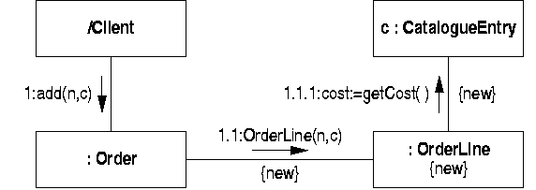
Creating an Order Line (2)
The equivalent collaboration diagram is:

Slide 18
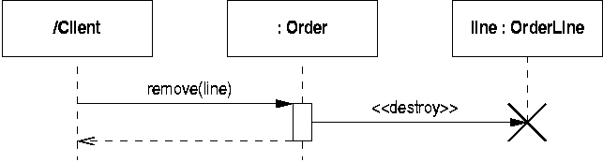
Object Destruction (1)
On a sequence diagram
  a destructor message terminates lifeline
  identified by the stereotype ‘<<destroy>>’

Slide 19
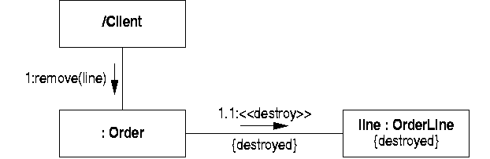
Object Destruction (2)
On a collaboration diagram
  destroyed objects and links are annotated with the property ‘{destroyed}’

Slide 20
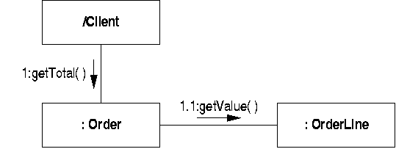
Role Multiplicity
The number of objects playing a role can vary from one occasion to another
  finding the total value of an order will depend on how many lines there are

Slide 21
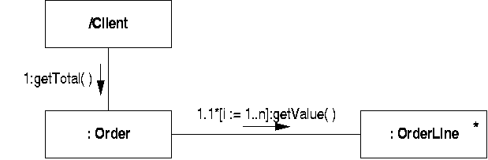
Iterated Messages
We can clarify this by
  adding a multiplicity to the affected role
  specifying that the message is iterated

Slide 22

Multiobjects
A multiobject denotes a collection of objects
It implies an intermediate data structure, eg

Slide 23
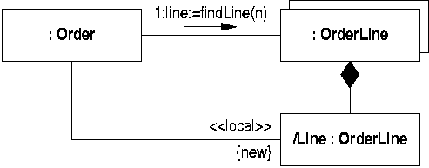
Finding Individual Objects
A multiobject represents a collection of objects
  it can be the target for messages that perform some operation - eg search - on the collection

Slide 24
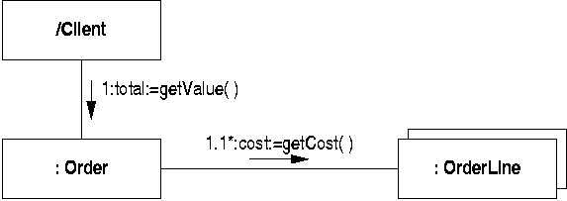
Messages to Multiobjects
Iterated messages to multiobjects are understood to be sent to individual objects

Slide 25
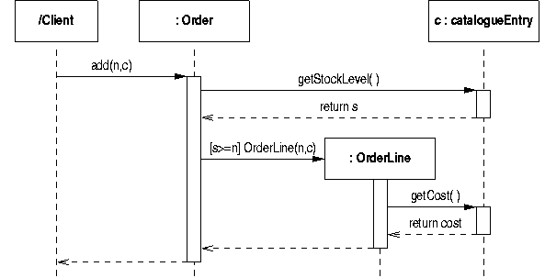
Conditional Messages
Conditions can be added to messages to show the situations when they are sent

Slide 26
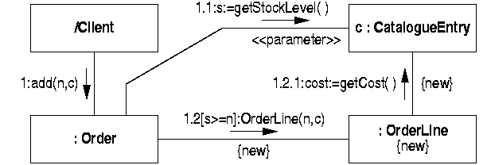
Conditional Messages
Conditions can also appear on collaboration diagrams

Slide 27
Alternative Flows
Sequence diagrams can show alternative message sequences
  two or more messages start at same point
  they are distinguished by conditions
  return messages come together later
  objects that receive message may need branching lifelines
This is a complex notation
  separate diagrams are often clearer

Slide 28
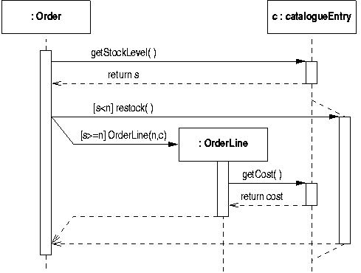
Alternative Message Sequences
Restock when an item runs out:

Slide 29
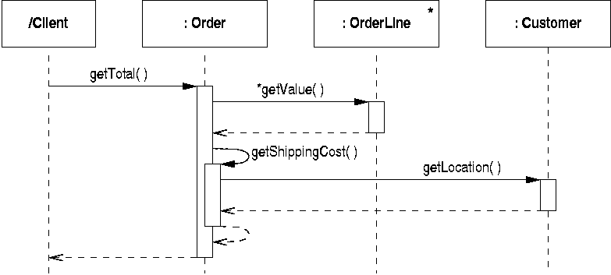
Messages to Self
Messages to self generate nested activations

Slide 30
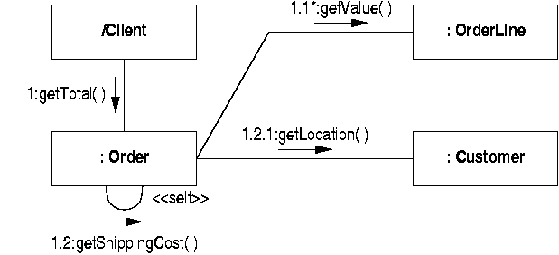
Messages to Self
On collaboration diagrams an extra level of message numbering is generated

